Slide 1


Slide 2
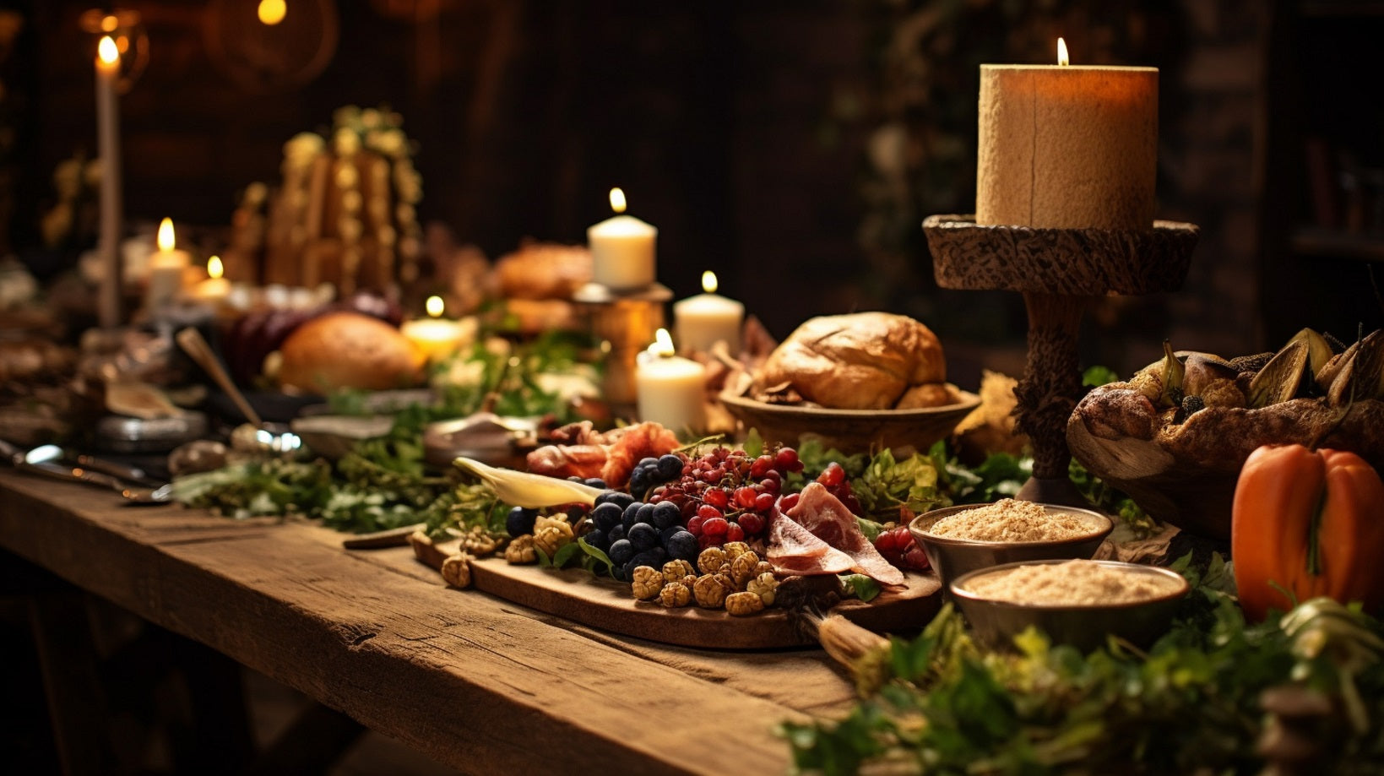
2 FEASTS

Slide 3
2 FEASTS
2 KINGS

Slide 4
2 FEASTS
2 KINGS
2 ENDINGS

Slide 5
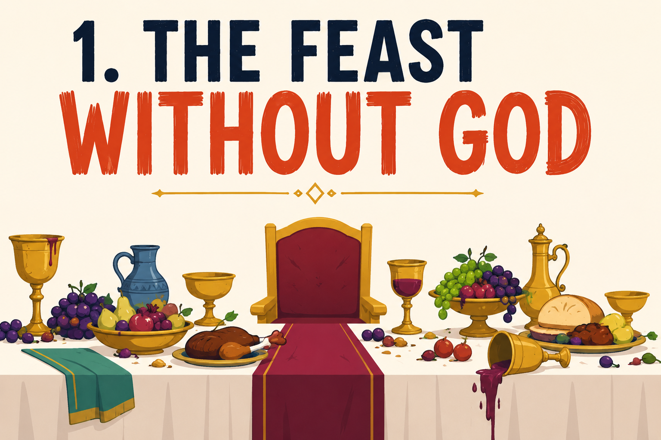

Slide 6
THE FEAST WITHOUT GOD
King Belshazzar gave a great banquet for a thousands of his nobles and drank wine with them [v.1]

Slide 7
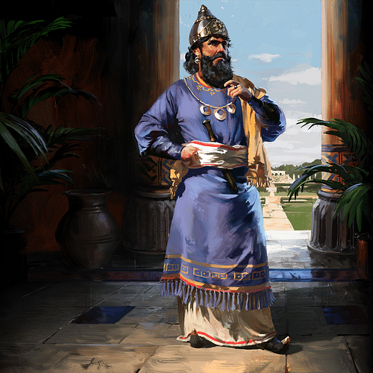
THE FEAST WITHOUT GOD
King Belshazzar gave a great banquet for a thousands of his nobles and drank wine with them [v.1]

Slide 8
THE FEAST WITHOUT GOD
King Belshazzar gave a great banquet for a thousand of his nobles and drank wine with them [v.1]

Slide 9
THE FEAST WITHOUT GOD
King Belshazzar gave a great banquet for a thousands of his nobles and drank wine with them [v.1]

Slide 10
THE FEAST WITHOUT GOD
King Belshazzar gave a great banquet for a thousands of his nobles and drank wine with them [v.1]

Slide 12
  But you Belshazzar have set yourself up against the Lord of heaven…and you praised the gods of silver and gold and bronze iron wood and stone which cannot see or hear or understand. But you did not honour the God who holds in his hand your life and all your ways.
  Daniel 5:22-25

Slide 14
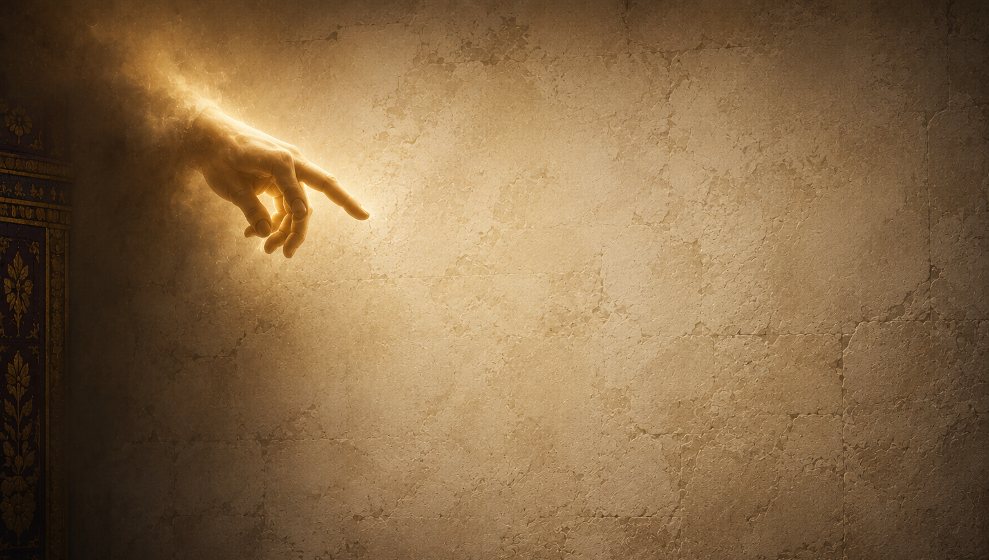
MENE
MENE
TEKEL
PARSIN
MENE
MENE
TEKEL
PARSIN

Slide 15
OUR DAYS ARE NUMBERED
MENE
MENE
TEKEL
PARSIN

Slide 16
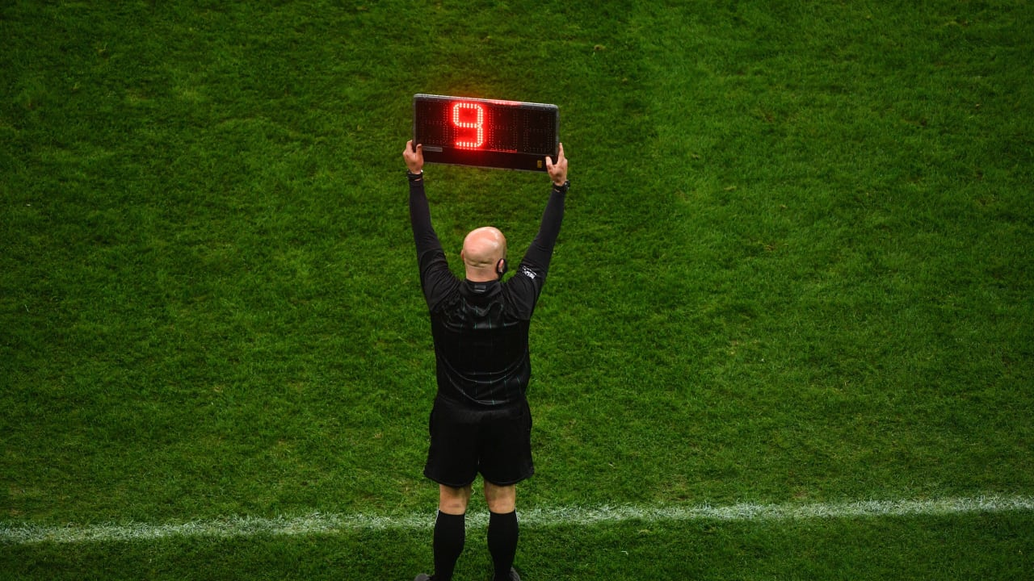

Slide 17
OUR DAYS ARE NUMBERED
WE ARE FOUND WANTING
MENE
MENE
TEKEL
PARSIN

Slide 18
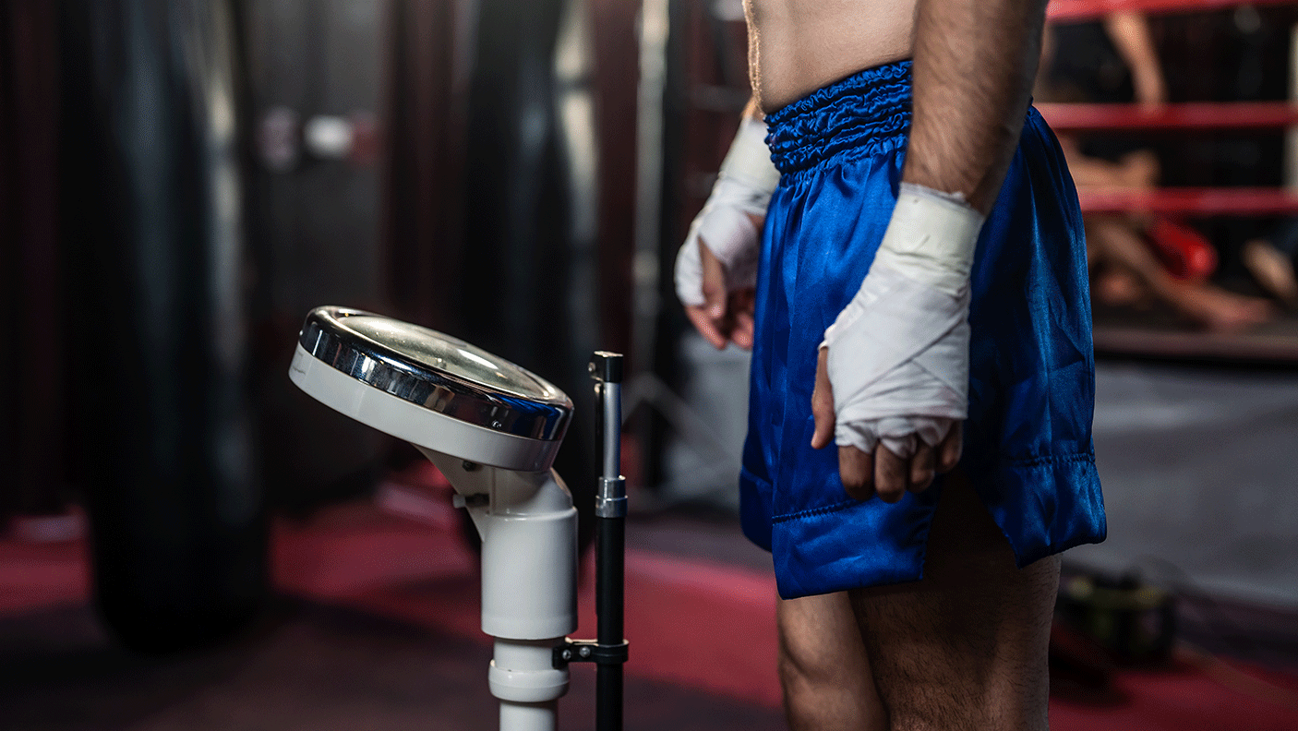

Slide 19
OUR DAYS ARE NUMBERED
WE ARE FOUND WANTING
OUR STUFF WON’T LAST
MENE
MENE
TEKEL
PARSIN

Slide 21


Slide 22
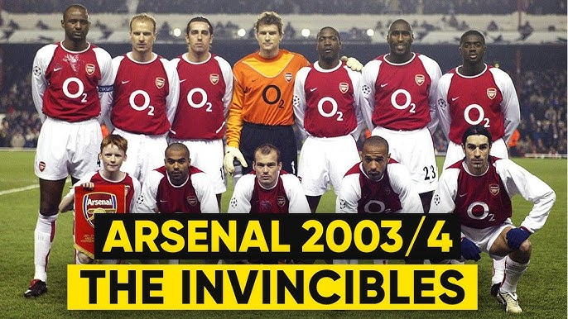

Slide 24
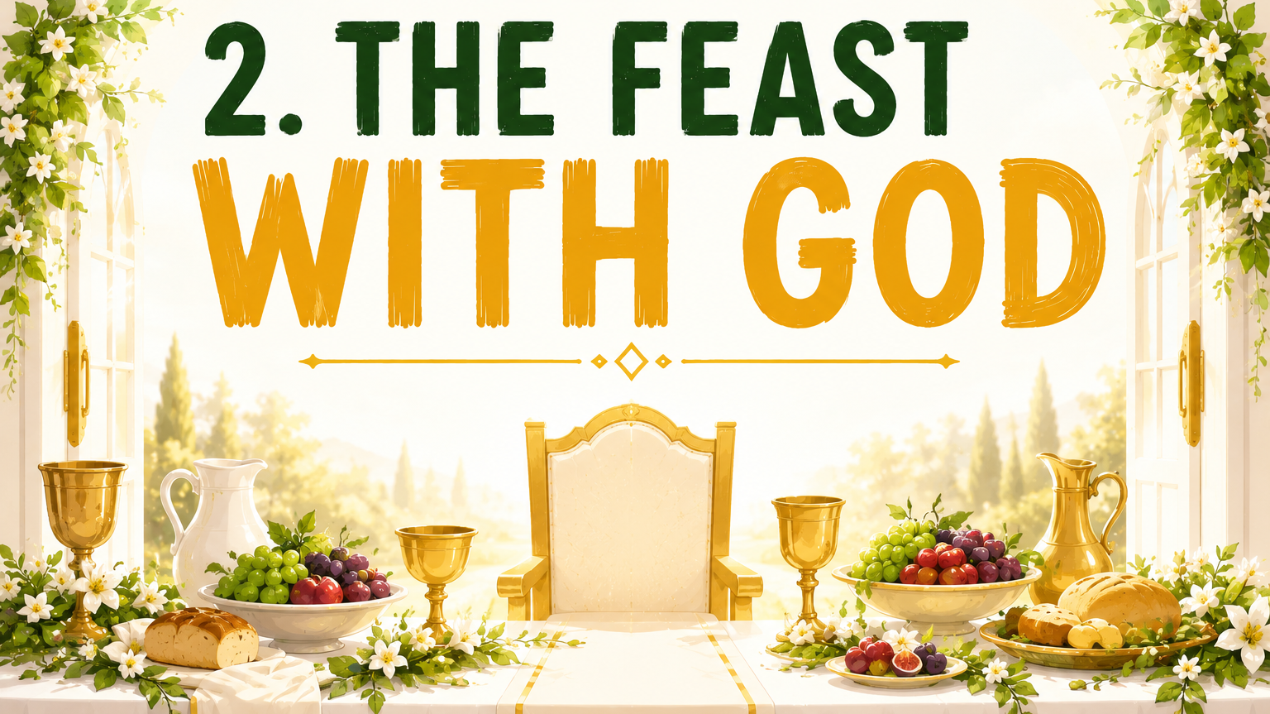

Slide 25
THE FEAST WITH GOD [Revelation 19:6-9]
Hosted by King Jesus
For the wedding of the Lamb has come [7]

Slide 26
THE FEAST WITH GOD [Revelation 19:6-9]
Attended by many VIP’s
Then I heard what sounded like a great multitude… [6]
For the wedding of the Lamb has come, and his bride has made herself ready. Fine linen, bright and clean, was given her to wear. [7-8]

Slide 27
THE FEAST WITH GOD [Revelation 19:6-9]
Full of noise
Then I heard what sounded like a great multitude, like the roar of rushing waters and like loud peals of thunder, shouting: “Hallelujah! For our Lord God Almighty reigns. [6]

Slide 28
THE FEAST WITH GOD [Revelation 19:6-9]
Full of happiness
Let us rejoice and be glad and give him glory! [7]

Slide 30
2 FEASTS
2 KINGS
2 ENDINGS

